Slide 1




Slide 2

Mission Statement
The jewelry market is highly competitive. Understanding and adapting to customer preferences is key in order to be successful. Out of the all the products the Bling Jewelry launches every year, only 20% turn out to be bestsellers. Being able to identify these products in advance would reduce losses and improve sales, as potential bestsellers could be targeted and prioritized across all business functions. It could also impact product design if trends and desired factors where known.
Business Perspective: This project approaches the business problem from a data mining perspective, by building a classifier based on online purchase data of the past five years, in order to support Bling Jewelry in identifying the factors that predict future bestseller products. Optimization techniques will be used to maximize business metrics, such as profit. A dashboard will be provided to business users that communicates customer buying trends and preferences.
Customer Perspective: An interactive chatbot will be provided to customers that will allow them to input their jewelry preferences. In return, the chatbot will use this information to “curate” a selection of pieces for the consumer. They can purchase on the spot or enroll in a subscription box.
Proposed IBM Solutions
IBM Watson Studio
IBM Watson Machine Learning
IBM Decision Optimization
IBM Data Refinery
Watson Knowledge Catalog
IBM Watson Assistant
IBM Watson Visual Recognition
IBM Cognos
IBM Cloud Pak for Data

Slide 3
PyRK8 Team
Maureen Kinard (“ring” leader)
Amanda Utstein
Christopher T Rodgers
Erin Scott
Laura Sandhya Money
Luv Aggarwal
Melanie Brunache
Box Folder: https://ibm.box.com/s/s4kbpugvt6dpo970ia931j4fxmd7qmb5
GitHub Folder: https://github.com/luvaggarwal/PyR-Tous-Final-Project
Project Milestones
Week of Jan 20 – Identify, cleanse, prep historical transactional and product data
Week of Jan 27 – Create Watson Assistant model to acquire customer preferences
Week of Feb 3 – Develop Watson Studio/ML models
Week of Feb 10 – Develop Decision Optimization models
Week of Feb 17 – Fast Start 2020
Week of Feb 24 – Create Cognos dashboards for business users
Week of Mar 2 – Finalize and create demo video
Week of Mar 9 – Prepare for Final Presentation

Slide 4
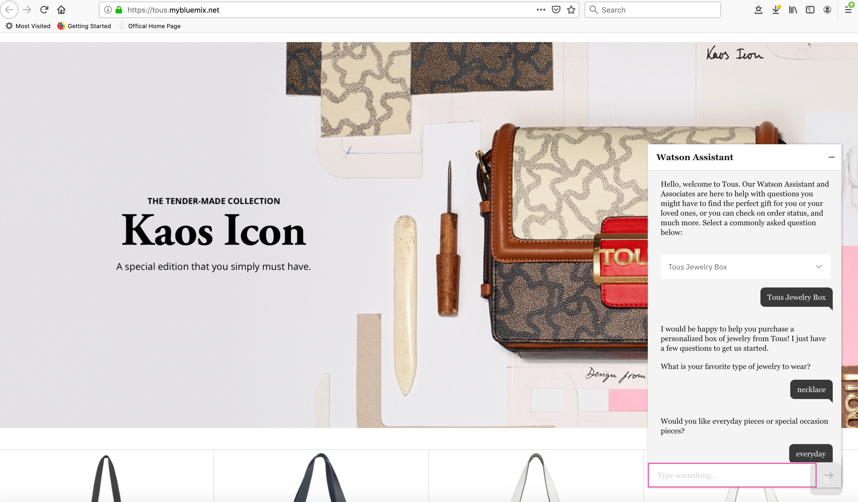
Watson Assistant Engagement with Customer

Slide 5
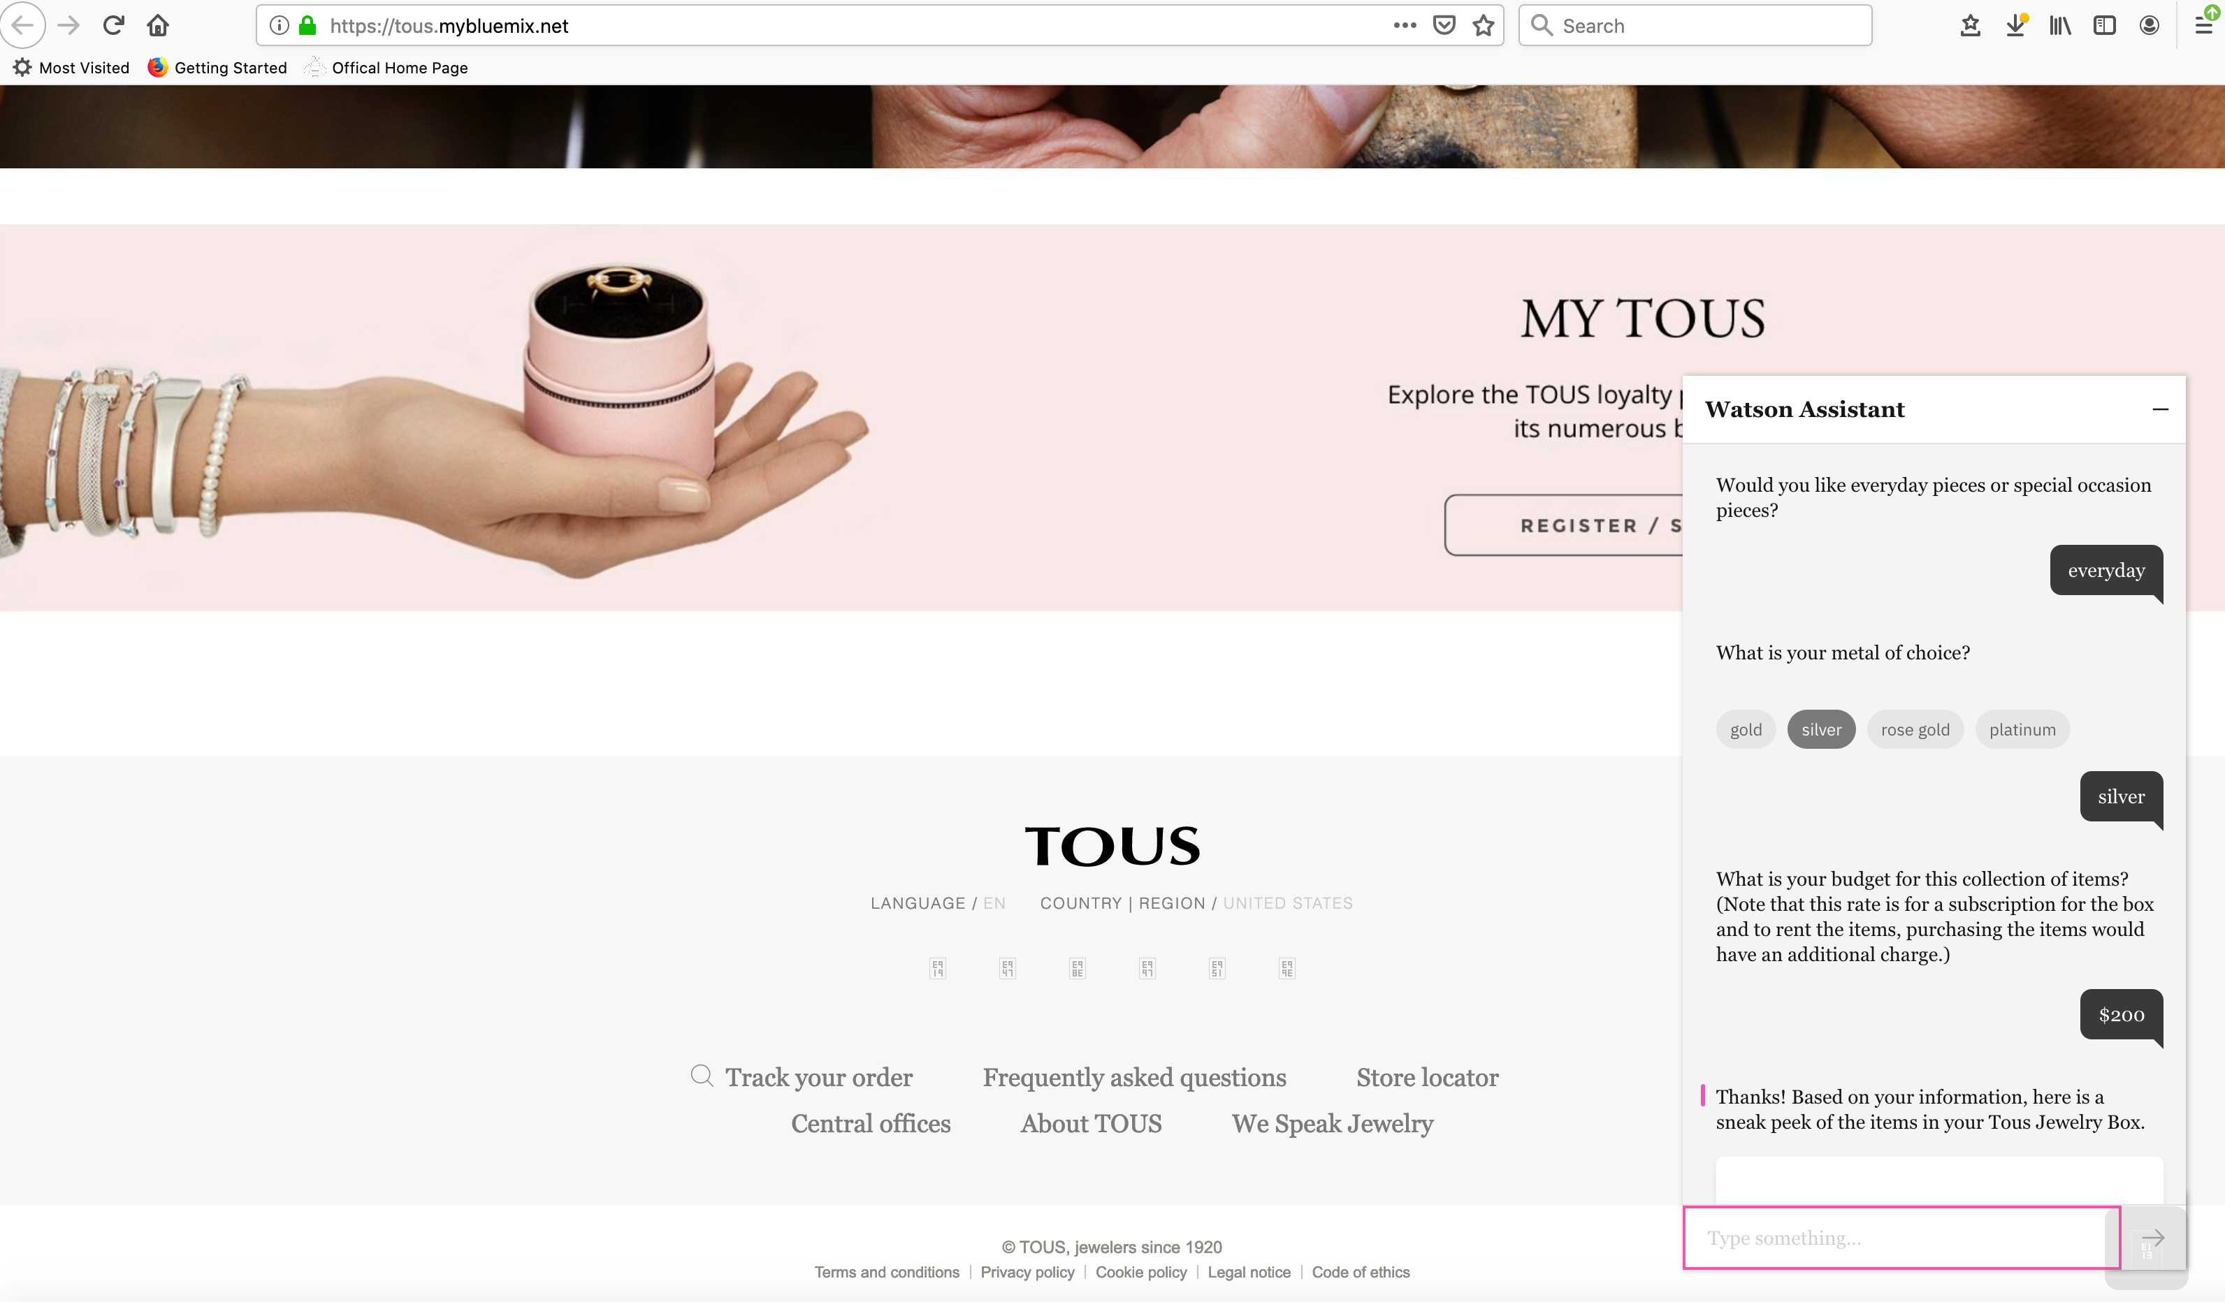
Watson Assistant engagement with customer

Slide 6
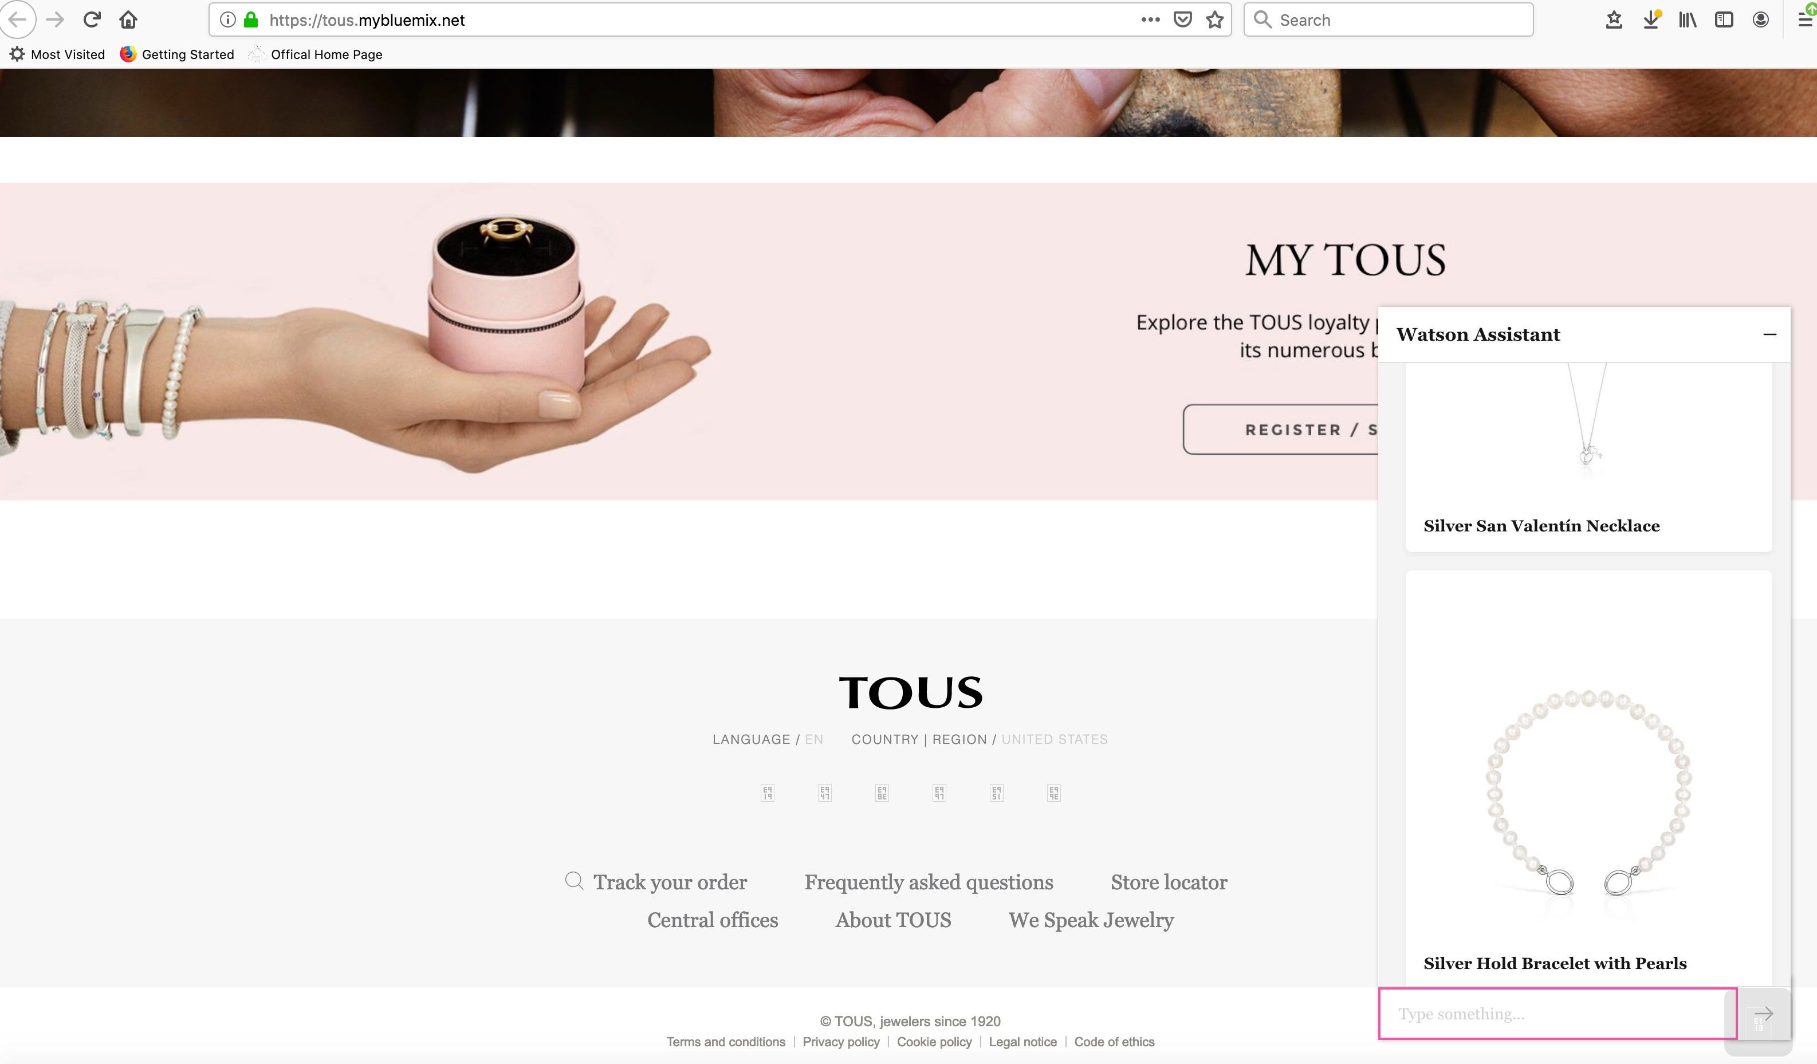
Watson Assistant engagement with customer

Slide 7
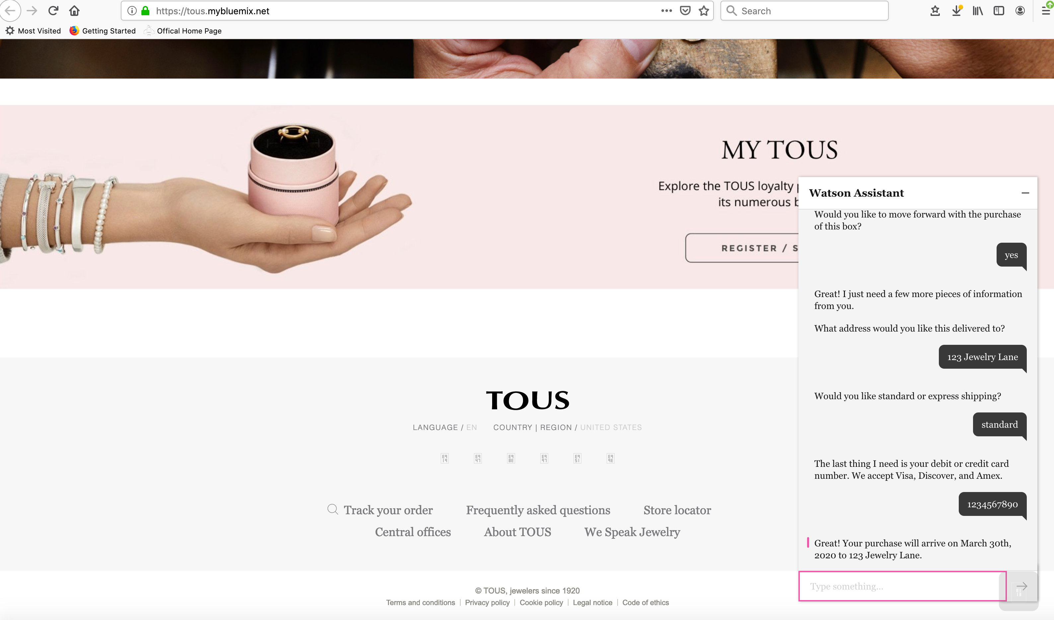
Watson Assistant engagement with customer

Slide 8
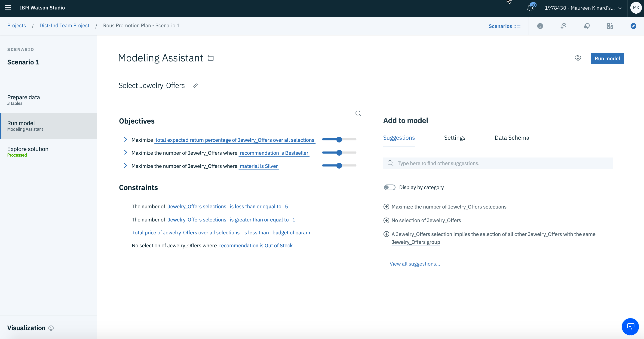
Curate a ”Jewelry Box” for a Customer using Decision Optimization

Slide 9
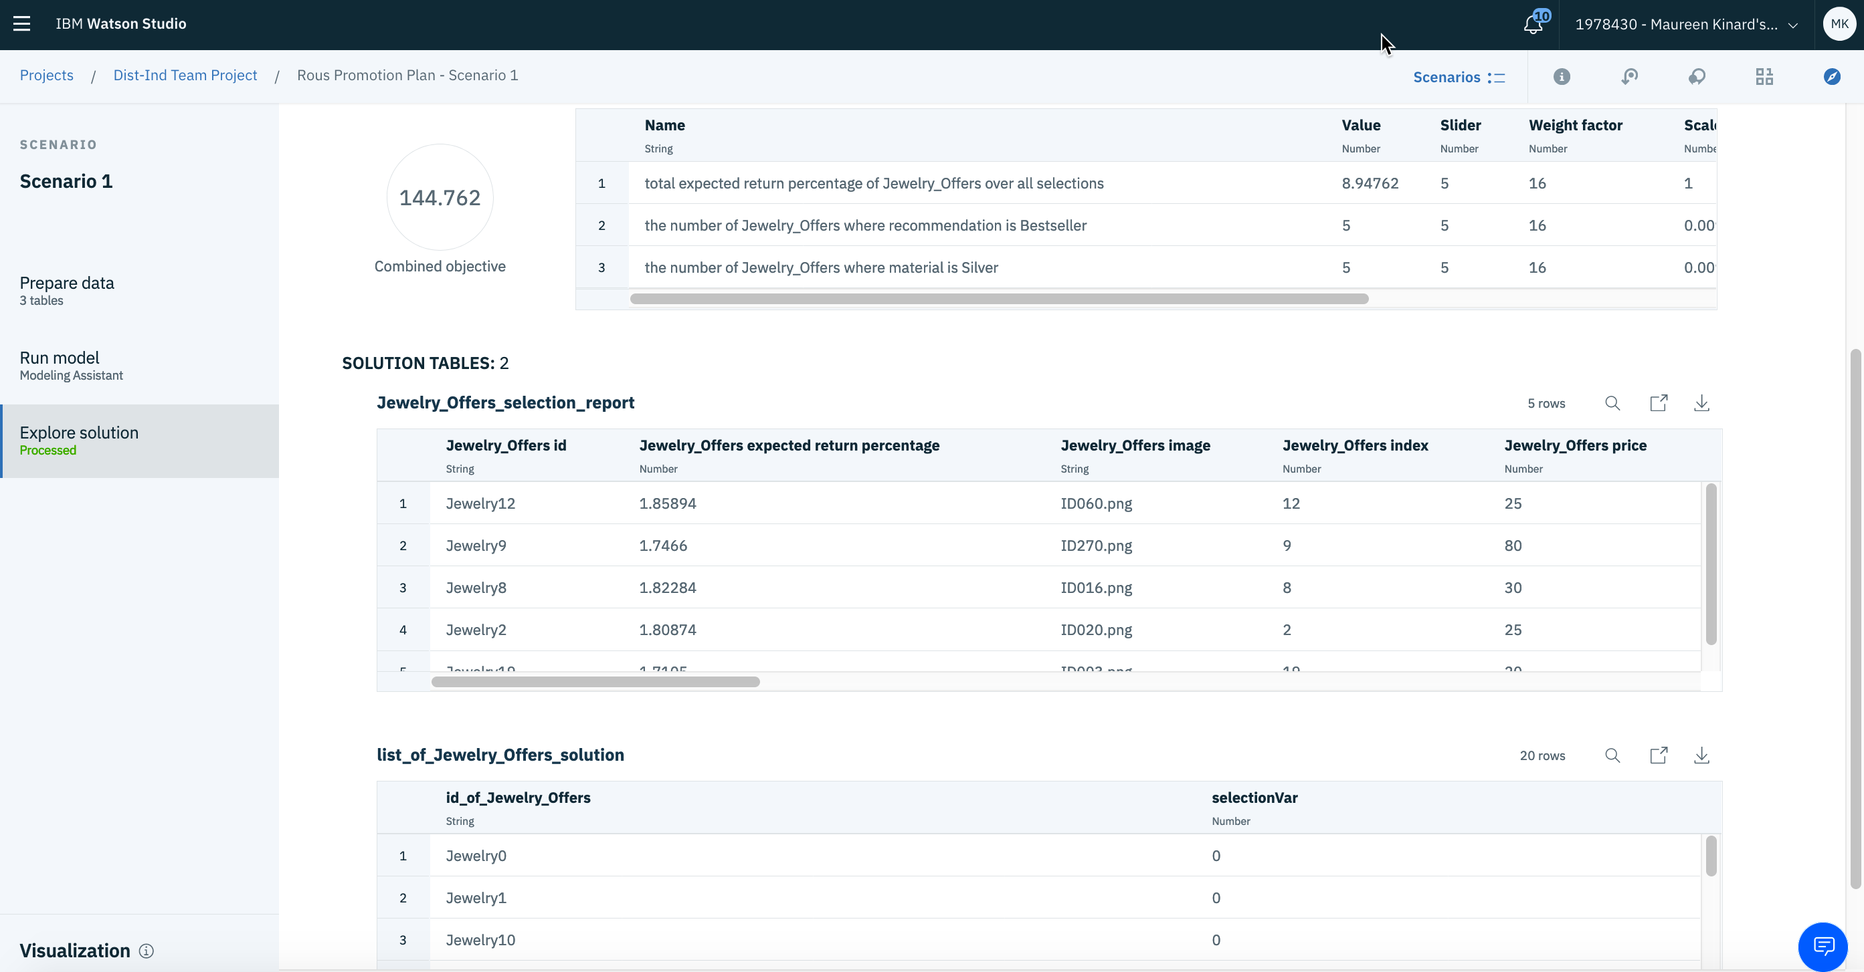
Curate a ”Jewelry Box” for a Customer using Decision Optimization

Slide 10
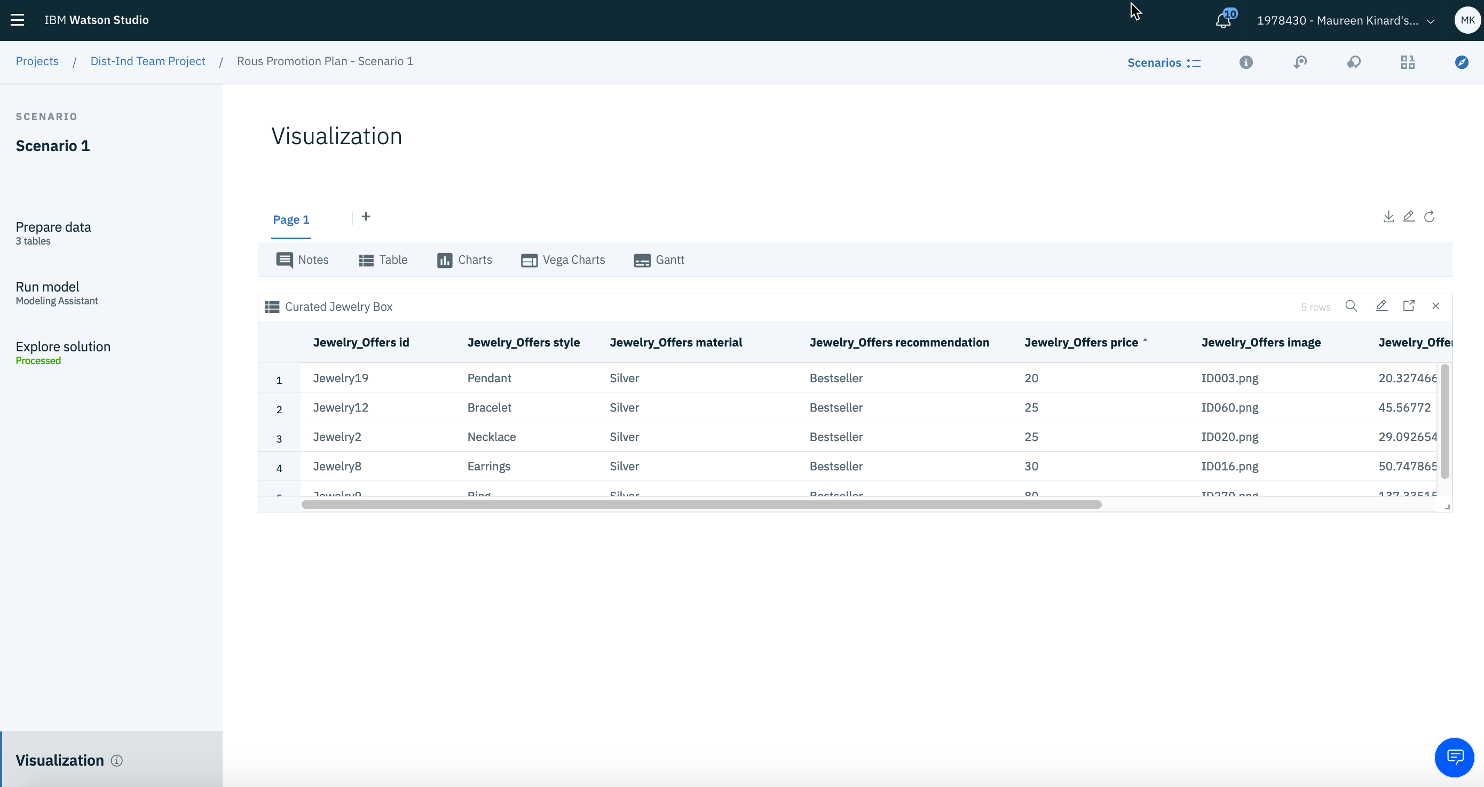
Curate a ”Jewelry Box” for a Customer using Decision Optimization
Result: Jewelry pieces selected based on goals and constraints

Slide 11
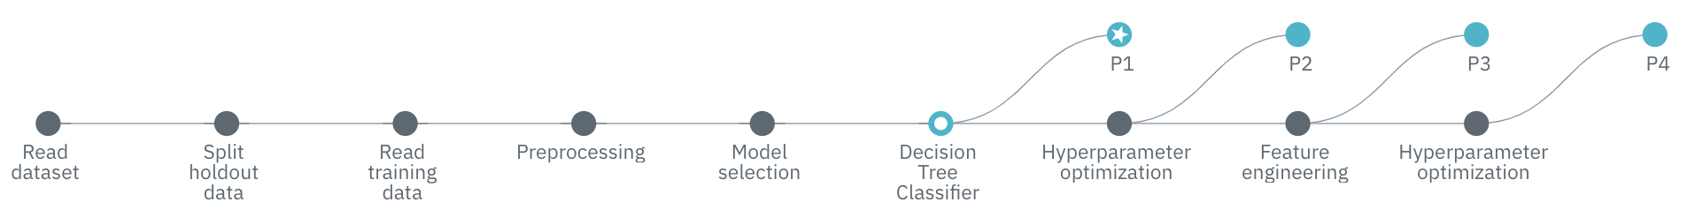
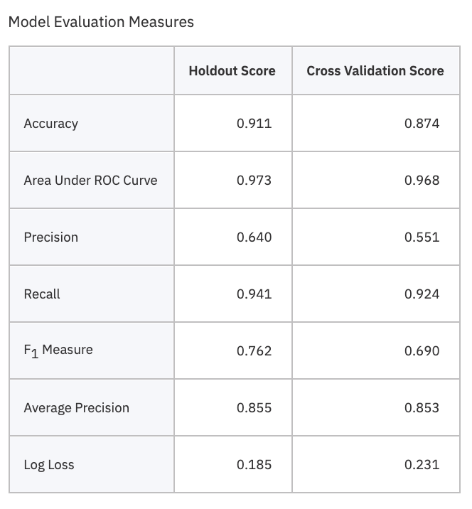
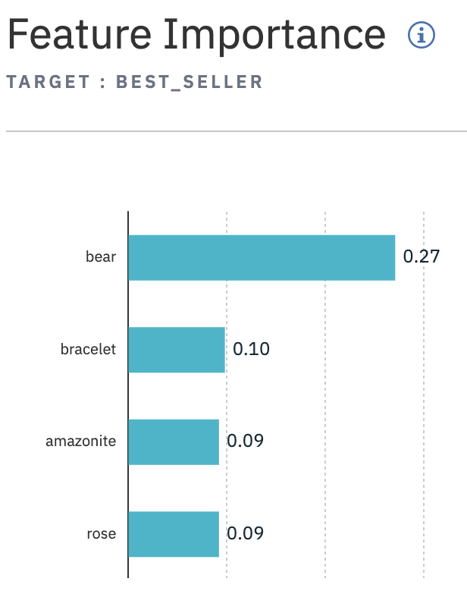
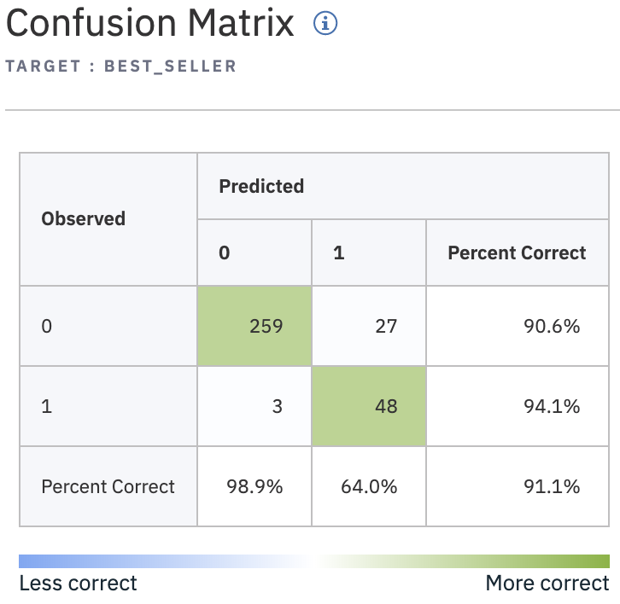
Watson Studio/Auto AI to Identify Characteristics of Jewelry Bestsellers

Slide 12
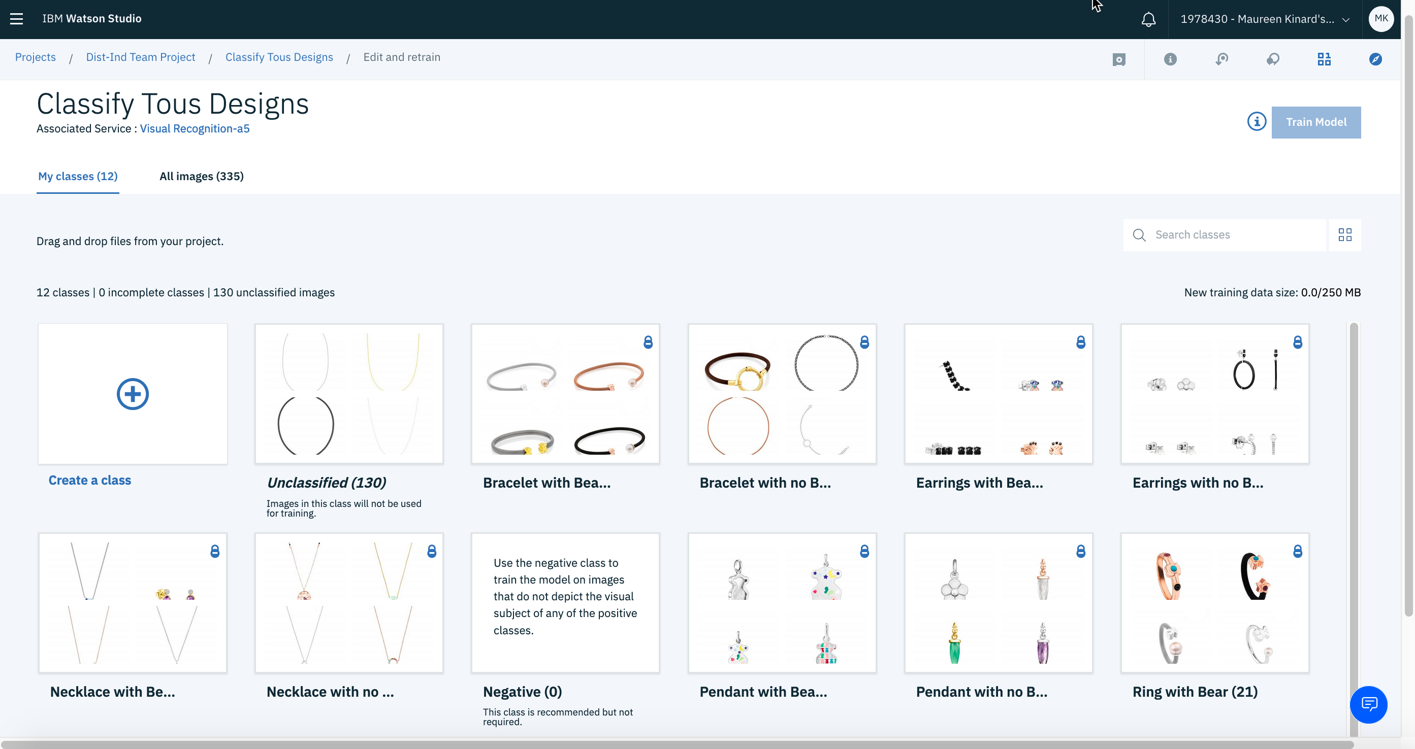
Classify Jewelry Characteristics using Watson Visual Recognition

Slide 13
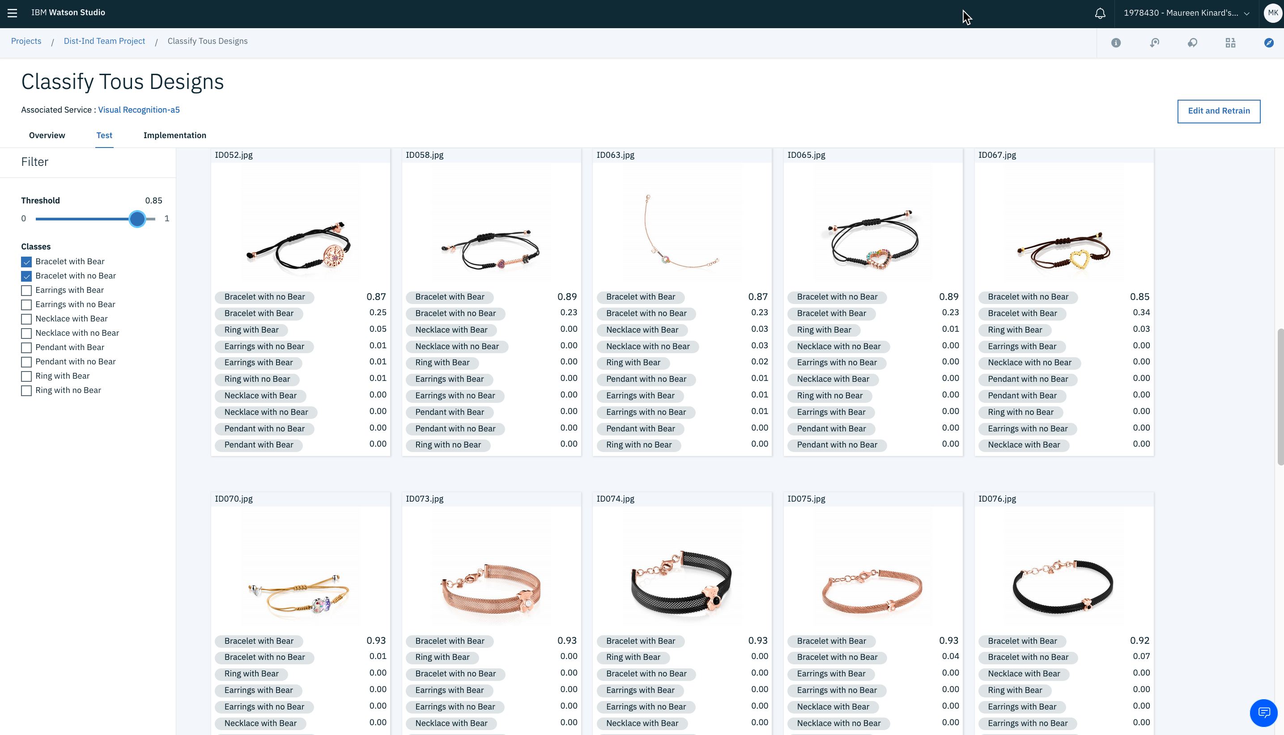
Classify Jewelry Characteristics using Watson Visual Recognition

Slide 14
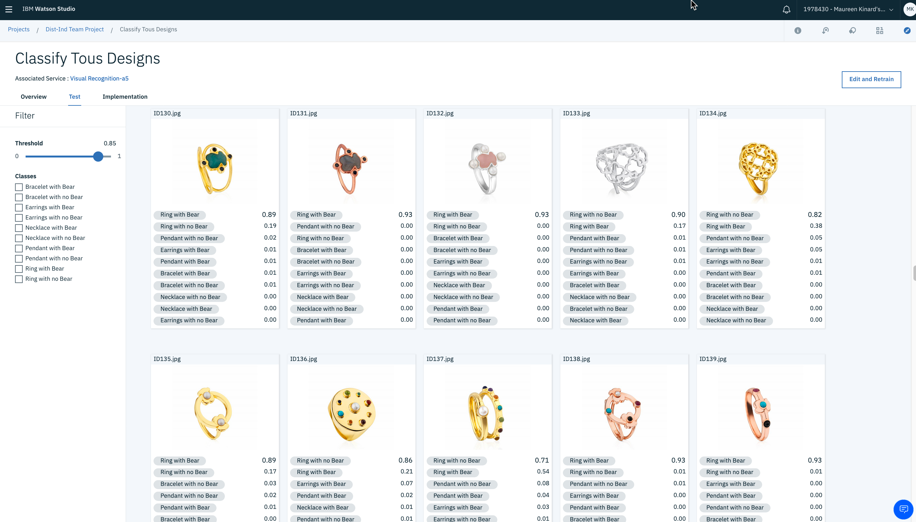
Classify Jewelry Characteristics using Watson Visual Recognition

Slide 15
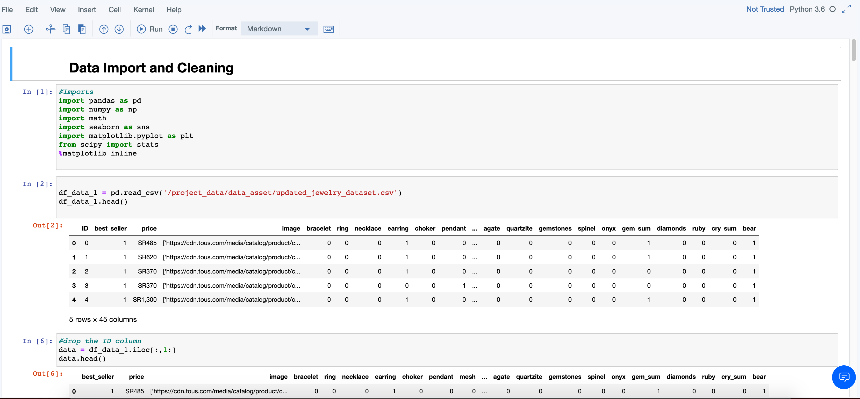
Data Cleansing using Python Code in Watson Studio

Slide 16
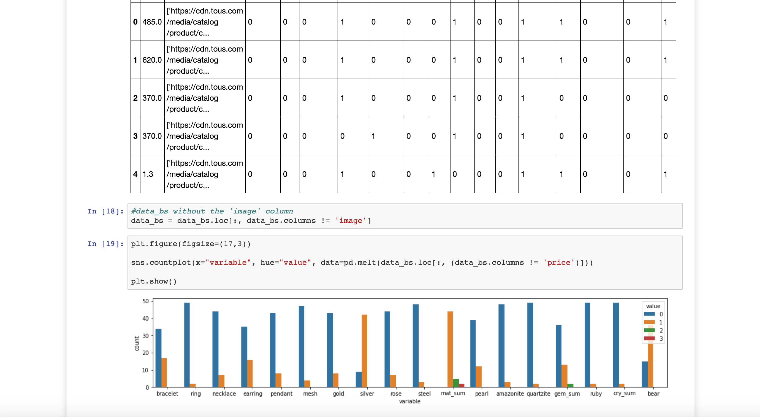
Data Cleansing using Python Code in Watson Studio

Slide 17
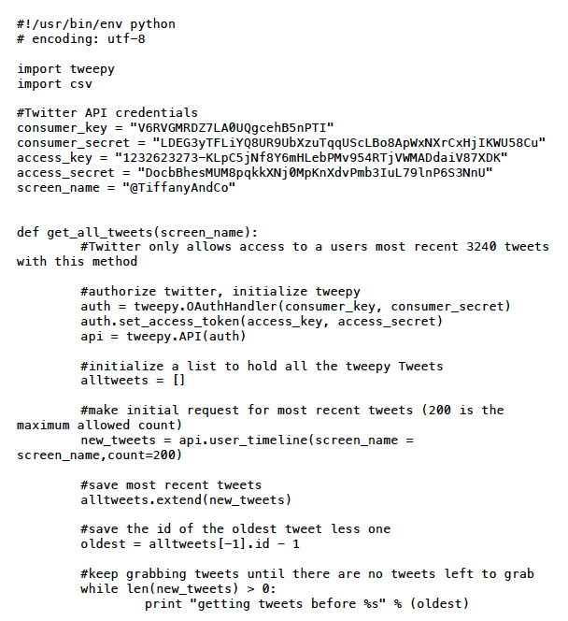
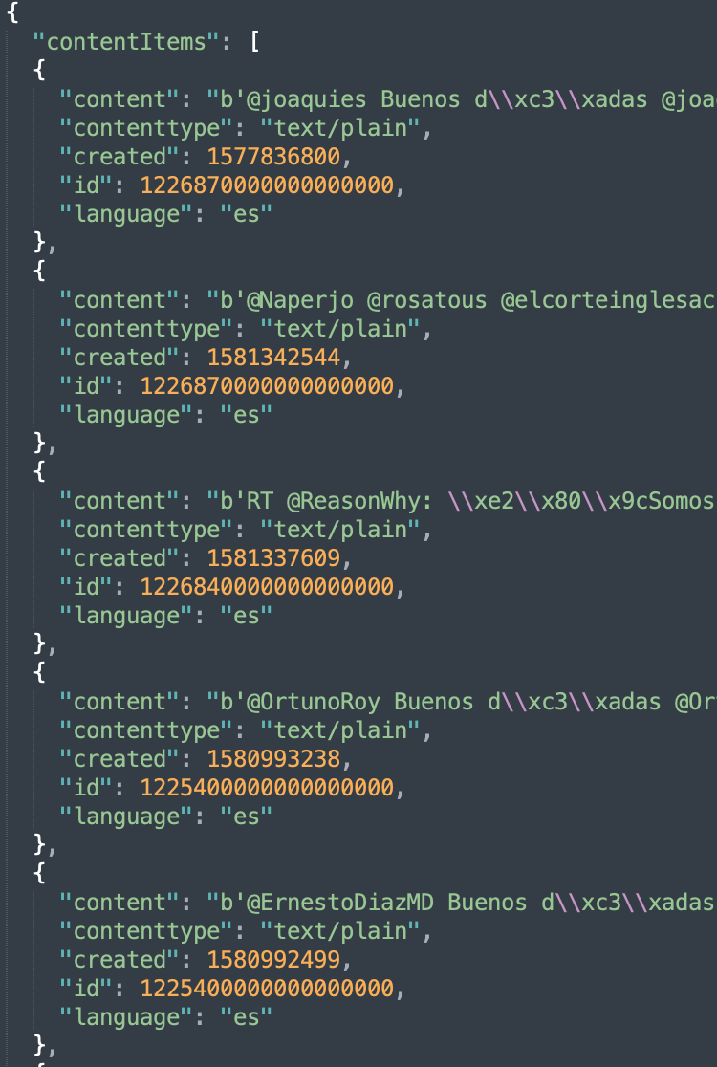
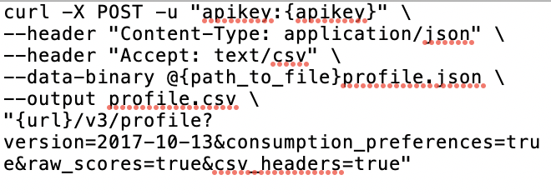
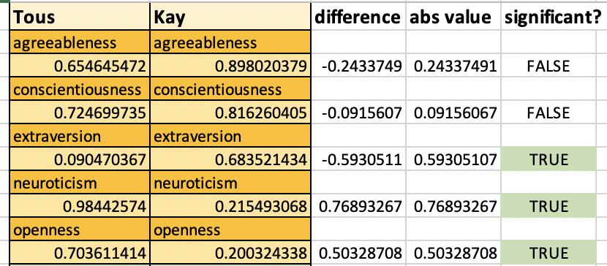
Twitter Sentiment Analysis
Download Tweets using Tweepy API
Format tweets in json to input to Personality Insights
Run Personality Insights on tweets
Analyze CSV output

Slide 18
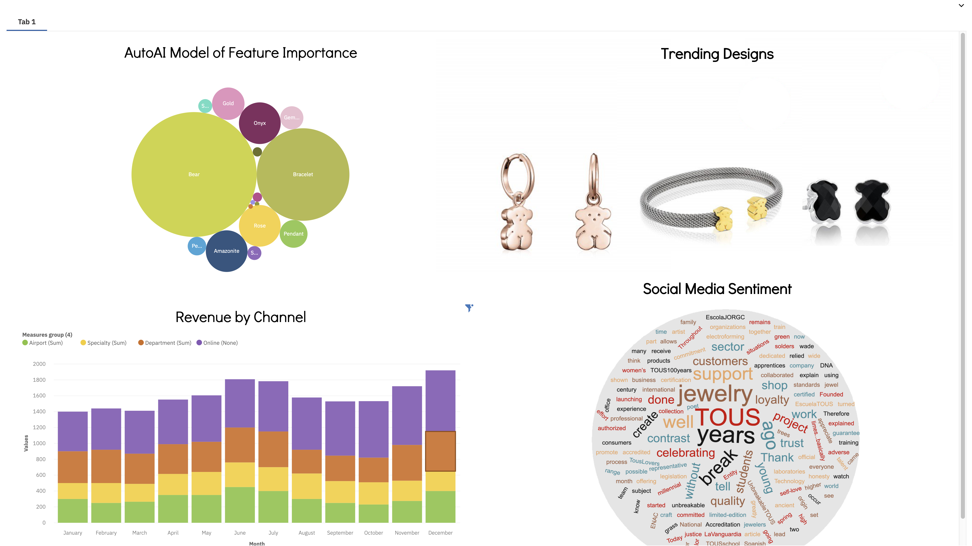
Cognos Dashboard to Present Summary Information to the Business

Slide 19
Potential Architecture
UI Interface
Watson Assistant
Dialog
Skills
Webhook
Cloud Function
User Interaction
End User
Cognos Dashboard
Business User
Data Sources
Data Prep / Repo
AI Layer
CSV File
Watson Studio
Notebook
Cognos Dashboard
Decision Optimization
Visual Recognition
Auto AI
Watson Machine Learning
Insights Preparation
Python Notebook
Cloud-Object Storage
Watson Studio

Slide 20
Demo Storyline
Customer View
Customer visits tous.com and initiates chat
Customer asks about different different types of jewelry and the chatbot presents some options based on that input
Customer pastes in a picture of Tous jewelry they saw on Instagram and wants to know more about it (Visual Recognition?)
Customer choose to “Create a Jewely Box” based on $200 budget and a preference for Silver material. Chatbot returns appropriate images of jewelry selected which meets customers criteria, but also maximizes Tous’ return (Decision Optimization)
Social Media? Watson Translation for Tous Twitter (in Spanish)
Business View and Behind the Scenes
Show architecture slide for flow of data
Db2 and Cloud Object Store used to store transactional data, product images and aggregated data/results
Watson Data Refinery (or WKC) was used to transform and prepare data for mining
Watson Studio is used to mine transactional data to determine bestsellers. Characteristics of a bestseller is then derived. Bestseller information is used to help determine inventory via channel (store/online), for use in promotions/campaigns, recommendations to the customer and feedback for product design
Decision Optimization is used to determine the best promotional offer based on customer characteristics and propensities. Those offers can be presented via the chatbot. This could also be used to “curate” a subscription box based on customer propensities and constraints
Watson Visual Recognition is used to categorize characteristics of the jewelry. This can expedite categorizing the images on the website, creating metadata for the images.
Cognos Analytics is used to summarize the state of the business: BestSellers, Sales, Channels

Slide 21
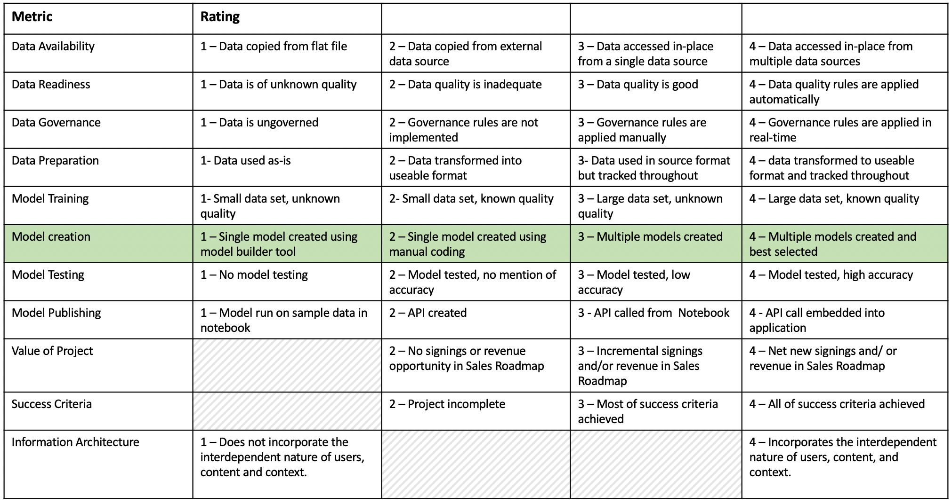
Project Rubric

